Slide 1
Intro to Derivatives: Options

Slide 2
Brainteaser!
There are 8 people sitting in a room at an investment bank. 4 of them are traders and 4 of them are bankers. They are split off into 4 teams of 2 for team-building exercises. What is the probability that each group of 2 has 1 trader and 1 banker?

Slide 3
Answer: Probability Approach
Select any person to be the first member of the group. 8/8 ways to do this. For their partner there are 4/7 valid people to select. Repeat for 2nd group, with 6/6 ways to select the first person and 3/5 ways to select the 2nd person. Same logic applies for 3rd group, for a total of 4/7 * 3/5 * 2/3 = 24/105 = 8/35. Note that we don’t have to worry about the 4th group because there will naturally be 1 banker and 1 trader left if the other groups are valid.

Slide 4
Answer: Combinations Approach
The total number of combinations is 8 choose 2 * 6 choose 2 * 4 choose 2 divided by 4! because the selection of groups does not require order. This comes out to 105 combinations. The number of valid groups can be thought of as 4*4 for group 1, 3*3 for group 2, 2*2 for group 3. Again divided by 4! because the order does not matter. This comes out to 24 valid combinations, for a total probability of 24/105 = 8/35

Slide 5
What Is a Derivative?
Derivative
A derivative is a financial instrument whose value is based on the value of another underlying asset
When the price of the underlying changes, the value of the derivative also changes

Slide 6
What Is a Derivative?
Types of Derivatives
Forwards/Futures
Options
Swaps
Warrants/Convertibles

Slide 7
Call option
An agreement that gives the buyer the right, but not the obligation, to buy an underlying asset at a specified price within a specific time period

Slide 8
Put option
An agreement that gives the buyer the right, but not the obligation, to sell an underlying asset at a specified price within a specific time period

Slide 9
Let's say you believe that the stock of Company XYZ, currently trading at $50, is going to rise in the next three months. You decide to purchase a call option on XYZ stock that expires in three months with a strike price of $55 for a premium (the price of the option) of $3.

Slide 10
Scenario 1: Stock Price Rises Above the Strike Price
If, after two months, XYZ stock rises to $65, your call option allows you to buy the stock at $55, even though it's now worth $65 on the open market. You could exercise the option, purchasing the stock at $55, and then sell it immediately in the market for $65, securing a profit.
Your profit would be the selling price minus the strike price minus the premium paid: $65 - $55 - $3 = $7 per share.
Scenario 2: Stock Price Remains Below the Strike Price
If, at expiration, XYZ stock is trading at $53, the call option is "out of the money," because the stock is trading below the strike price. Exercising the option would mean buying the stock for more than it's currently worth, so you choose not to exercise the option. Your loss is limited to the premium you paid for the option, which is $3 per share.

Slide 11
Other Key Terms To Know
What is the difference between the price of the underlying asset and the strike price?

Slide 12
2 Types of Options
American Options – buyer can exercise the option early, at any point up until expiration
European Options – buyer cannot exercise option early and has to wait until expiration

Slide 13
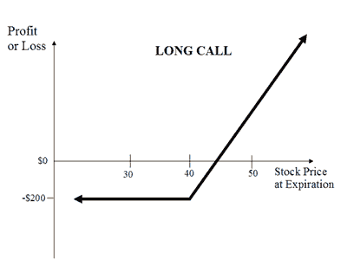
Payoff Diagram For Buying A Call

Slide 14
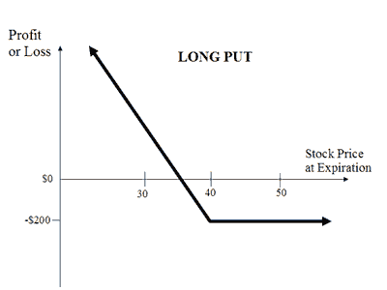
Payoff Diagram For Buying A Put

Slide 15
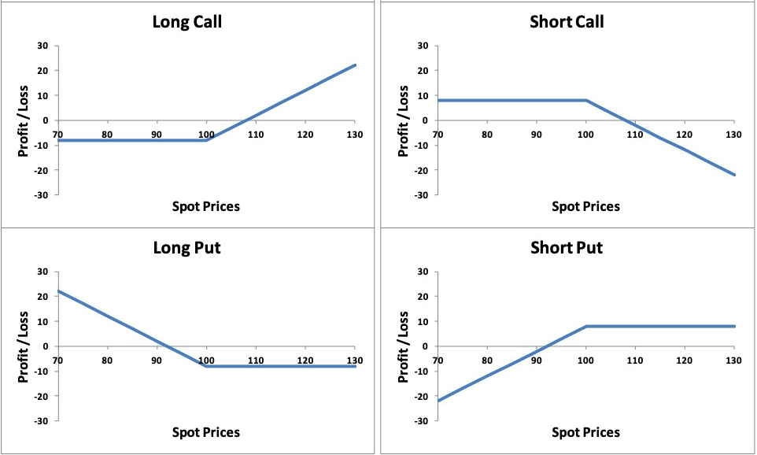
Summary Of Payoff Diagrams

Slide 16
Concept of Moneyness
Options are heavily dependent on the concept of moneyness – relative position of the price of the underlying asset with respect to the strike price of the option

Slide 17
Concept of Moneyness
In the Money
If expiration were today, the option would have value
At the Money
Strike price = Spot price
Out of the Money
If expiration were today, the option would be worthless

Slide 18
Why People Trade Options
Leverage
Hedging – Protected downside risk
Speculation

Slide 19
Options Chain Table

Slide 20
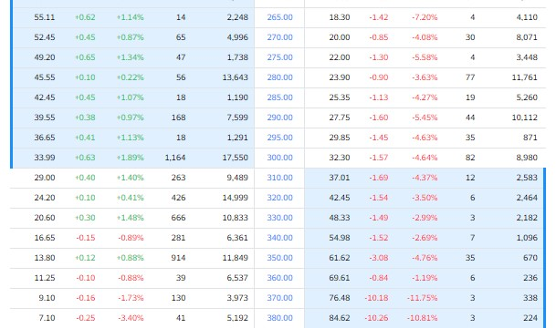
Should the right to buy for 300 and the right to sell at 300 be worth about the same, given the current stock price of 303.49?

Slide 21
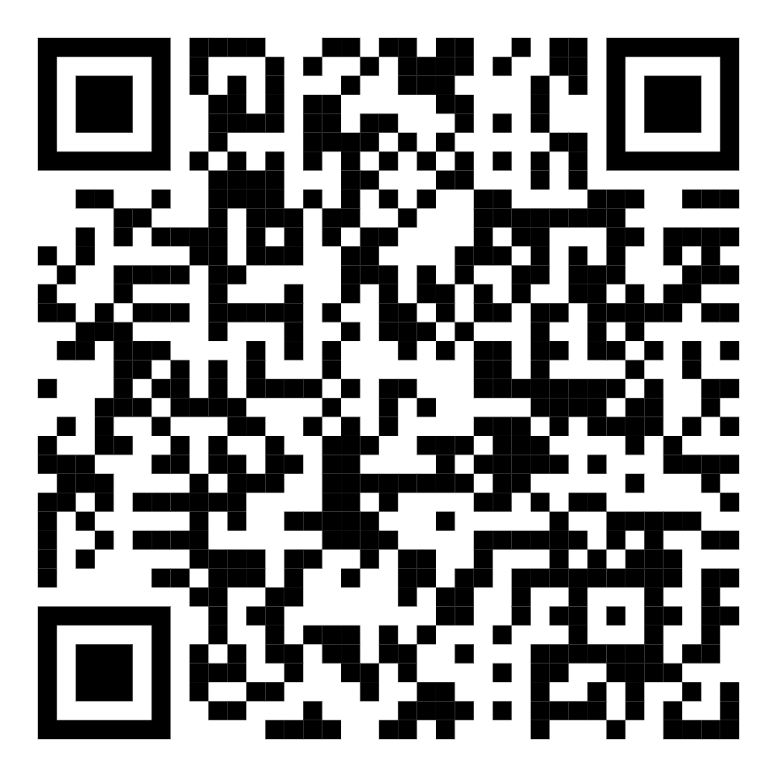
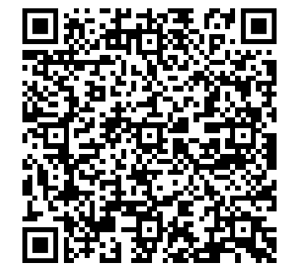
Attendance: QFA and Excel

Slide 22
Future topics
Futures/Forwards
Options on Futures
Greeks

Slide 23
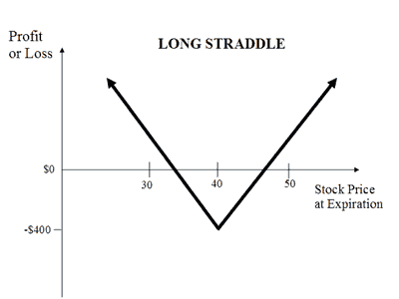
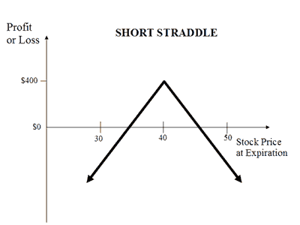
Different Strategies: Volatility Strategies

Slide 24
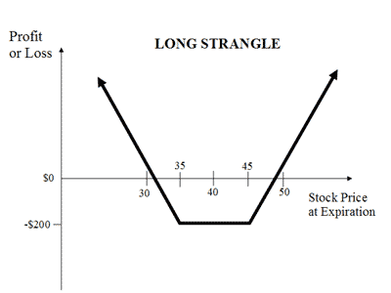
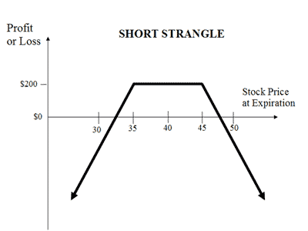
Different Strategies: Volatility Strategies

Slide 25
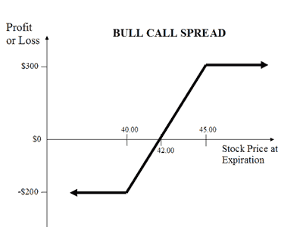
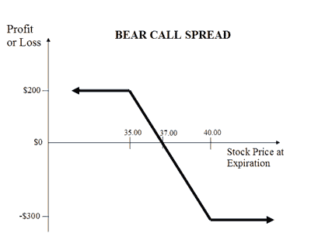
Different Strategies:

Slide 26
Pricing Exercise
How much do you think a call option should be priced if…
Strike price is 40
Price of underlying is 50
Expiration date is in a year

Slide 27
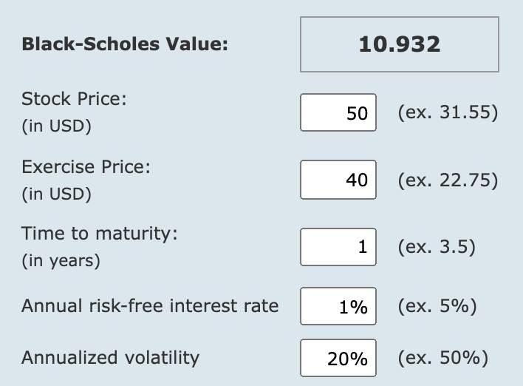
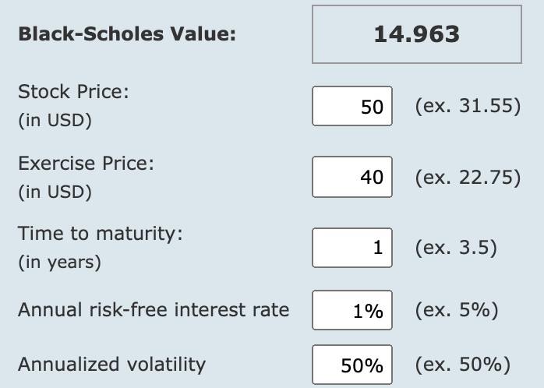
Pricing Exercise

Slide 28
Pricing Exercise
How much do you think a put option should be priced if…
Strike price is 40
Price of underlying is 40
Expiration date is in a year

Slide 29
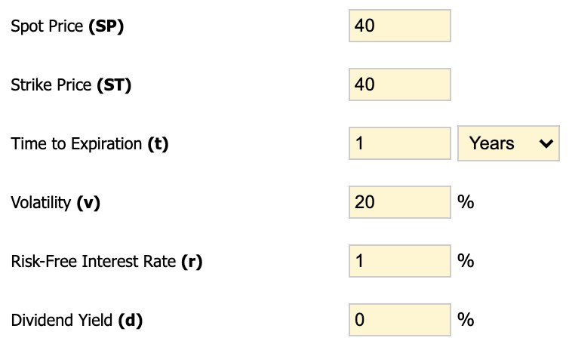
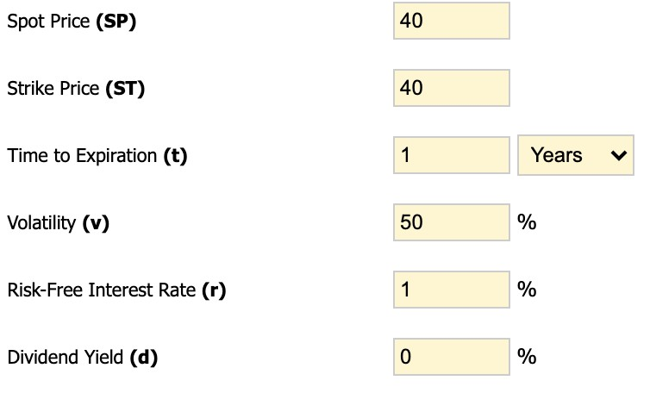
Pricing Exercise

Slide 30
Pricing Relationships
Max[0, S-K] <= C
C(K_{L}) > C(K_{H})
C(t₂) > C(t₁)
Max[0, K-S] <= P <= K
P(K_{L}) < P(K_{H})
P(t₂) > P(t₁)
S, K = spot price, strike price
K_{L}, K_{H} = lower strike, higher strike
T₁, T₂ = shorter maturity, longer maturity

Slide 31
Impact of Each Variable
What happens to the cost of a call option when the following variables change?
Price of underlying increases…
Strike price increases…
Volatility increases…
Time increases…
Interest rates increase…
Dividends increase…

Slide 32
Impact of Each Variable
What happens to the cost of a put option when the following variables change?
Price of underlying increases…
Strike price increases…
Volatility increases…
Time increases…
Interest rates increase…
Dividends increase…

Slide 33
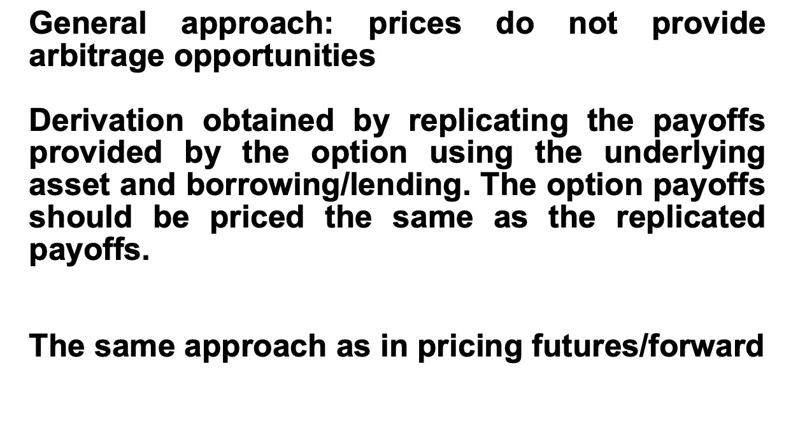
Put-Call Parity

Slide 34
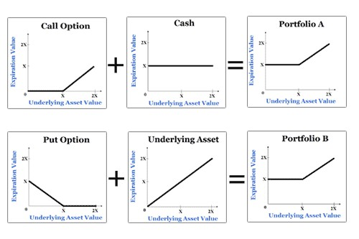
Put-Call Parity
Defines the relationship between the price of a European put and European call of the same class (same strike/underlying asset/expiration date)

