Slide 1
Algorithmic Trading 101
(new class at unc??? 🙏🙏🙏)
QFA 2024

Slide 2
About Me:
Name: Aaron
Major: Computer Science
Experience/Qualifications:
C/C++ SWE Intern previously
UTA for COMP 455
Incoming AppDev Intern for Vanguard
Notes:
Note to self: spend at most like 30 seconds here, not important, nobody cares

Slide 3
What about you guys?
Notes:
Ask:
How many are Quant, CS, Econ, or Busi majors?
How many are other STEM majors?
How many aren’t STEM at all?
Who has prior experience in coding?
What languages?

Slide 4
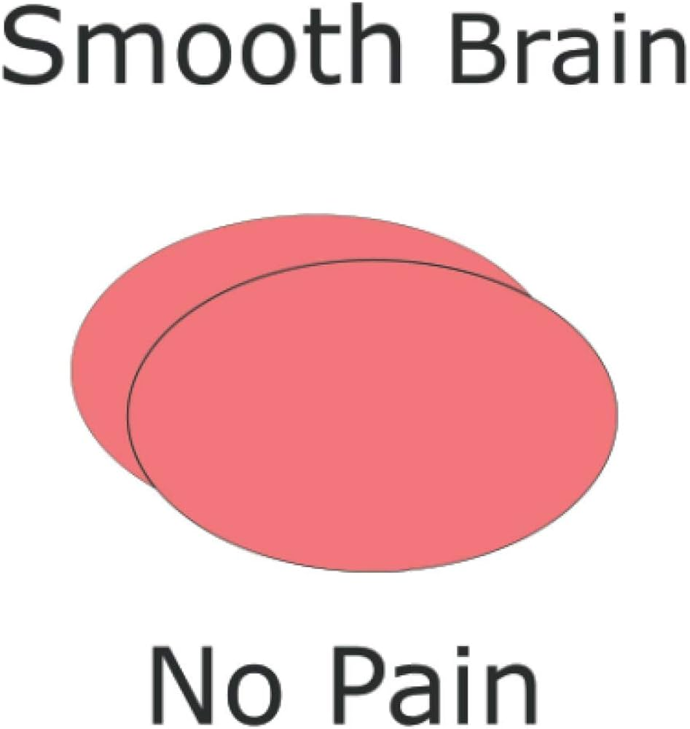
Brain Teaser Time:

Slide 5
Brain Teaser Time:
How many trailing zeros does 1000! have?

Slide 6
Brain Teaser Time:
How many trailing zeros does 1000! have?
A: 249

Slide 7
Brain Teaser Time:
How many trailing zeros does 1000! have?
A: 249

Slide 8
Brain Teaser Time:
How many trailing zeros does 1000! have?
A: 249

Slide 9
Brain Teaser Time:
How many trailing zeros does 1000! have?
A: 249

Slide 10
Brain Teaser Time:
How many trailing zeros does 1000! have?
A: 249

Slide 11
Brain Teaser Time:
How many trailing zeros does 1000! have?
A: 249

Slide 12
Brain Teaser Time:
How many trailing zeros does 1000! have?
A: 249

Slide 13
Brain Teaser Time:
How many trailing zeros does 1000! have?
A: 249

Slide 14
Brain Teaser Time:
How many trailing zeros does 1000! have?
A: 249

Slide 15
What is Algorithmic Trading?

Slide 16
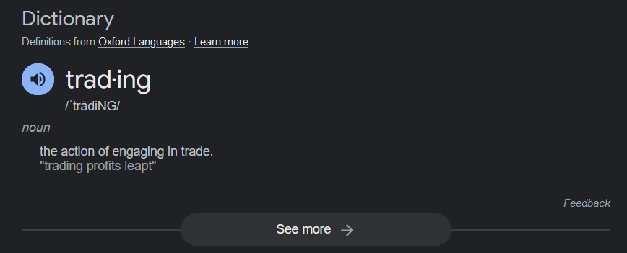
What is Trading?
Simplest terms: selling and buying stuff on the stock market
More complex terms:
Bidding on shares, futures offers at exchanges
Betting on performance, or lack thereof
Offering owned shares on the market

Slide 17
What are Algorithms (in trading)
Algorithms perform predefined tasks
Take arguments, parameters, data, etc
Create output
Trading algorithms
Get data from Exchange APIs
Analyze data
Calculate best actions,
Recommend actions to traders
Execute actions automatically

Slide 18
Common Trade Algorithms
Execution Algorithms:
Usually for large scale orders
Aid in re-allocating money from one asset to another
Might space out trades, attempt to reduce impact on price during executions
End goal is to reduce fluctuation in transaction pricing

Slide 19
Common Trade Algorithms
Behavior Exploitative Algorithms:
a.k.a. “I know your next move”
Analyze major opponents in the same market
How do they trade?
Can we reverse engineer their algorithms?
Deduce the rules behind trades
Probe for edge cases that break these rules
Utilize these cases to profit from opponents

Slide 20
Common Trade Algorithms
Scalping Algorithms:
Small, but fast
Focus on tiny differences in offers and bids
Must be quick in order to turn profits
Crowded market
Must also gracefully liquidate assets to minimize loss
Notes:
(last point) If you end up being beaten to fulfill an offer by someone else, your algorithm has to still liquidate the asset you’re holding on to in a controlled, predictable manner that minimizes your own losses.

Slide 21
Common Trade Algorithms
Predictive Algorithms:
Attempt to predict/model the future prices of stocks using past information, new information, and other second-order information
Fall into several subcategories:
Mean reversion
Trend following
Chart pattern recognition
Fundamental analysis
and more…
Notes:
Probably the first algorithm that everyone thinks of when they think about algorithms in general.

Slide 22
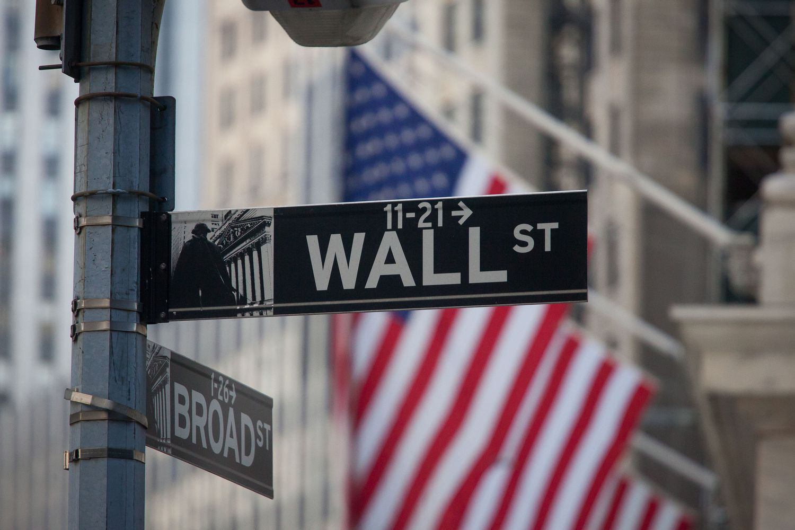
Who uses this?
Notes:
Most commonly used by large companies
Hedge Funds might use predictive algorithms
Market Makers like Optiver utilize scalping algorithms to turn profits
Most companies actively analyze not only their own trades but their competitors as well through behavior exploitative algorithms
Even individual traders can use these algorithms to aid them in making
decisions and executing trades
Platforms like Merril-Edge, Nadex, might provide these algorithms

Slide 23
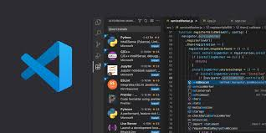
Languages + Tools
TF is this resolution??????
Notes:
Next we will talk about the languages that trade algorithms are written in.

Slide 24
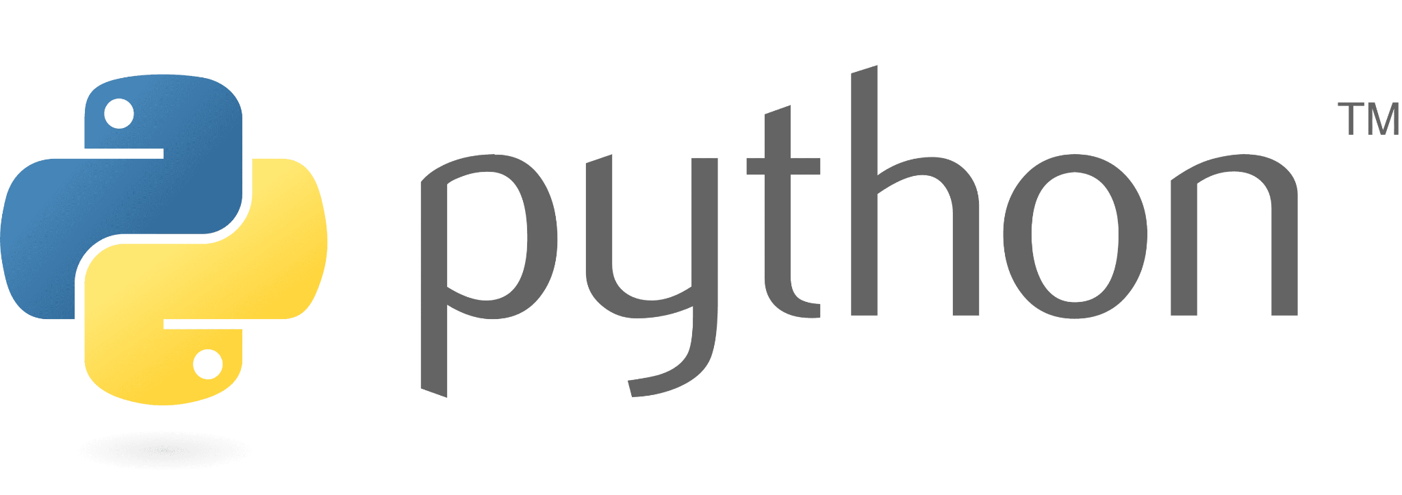
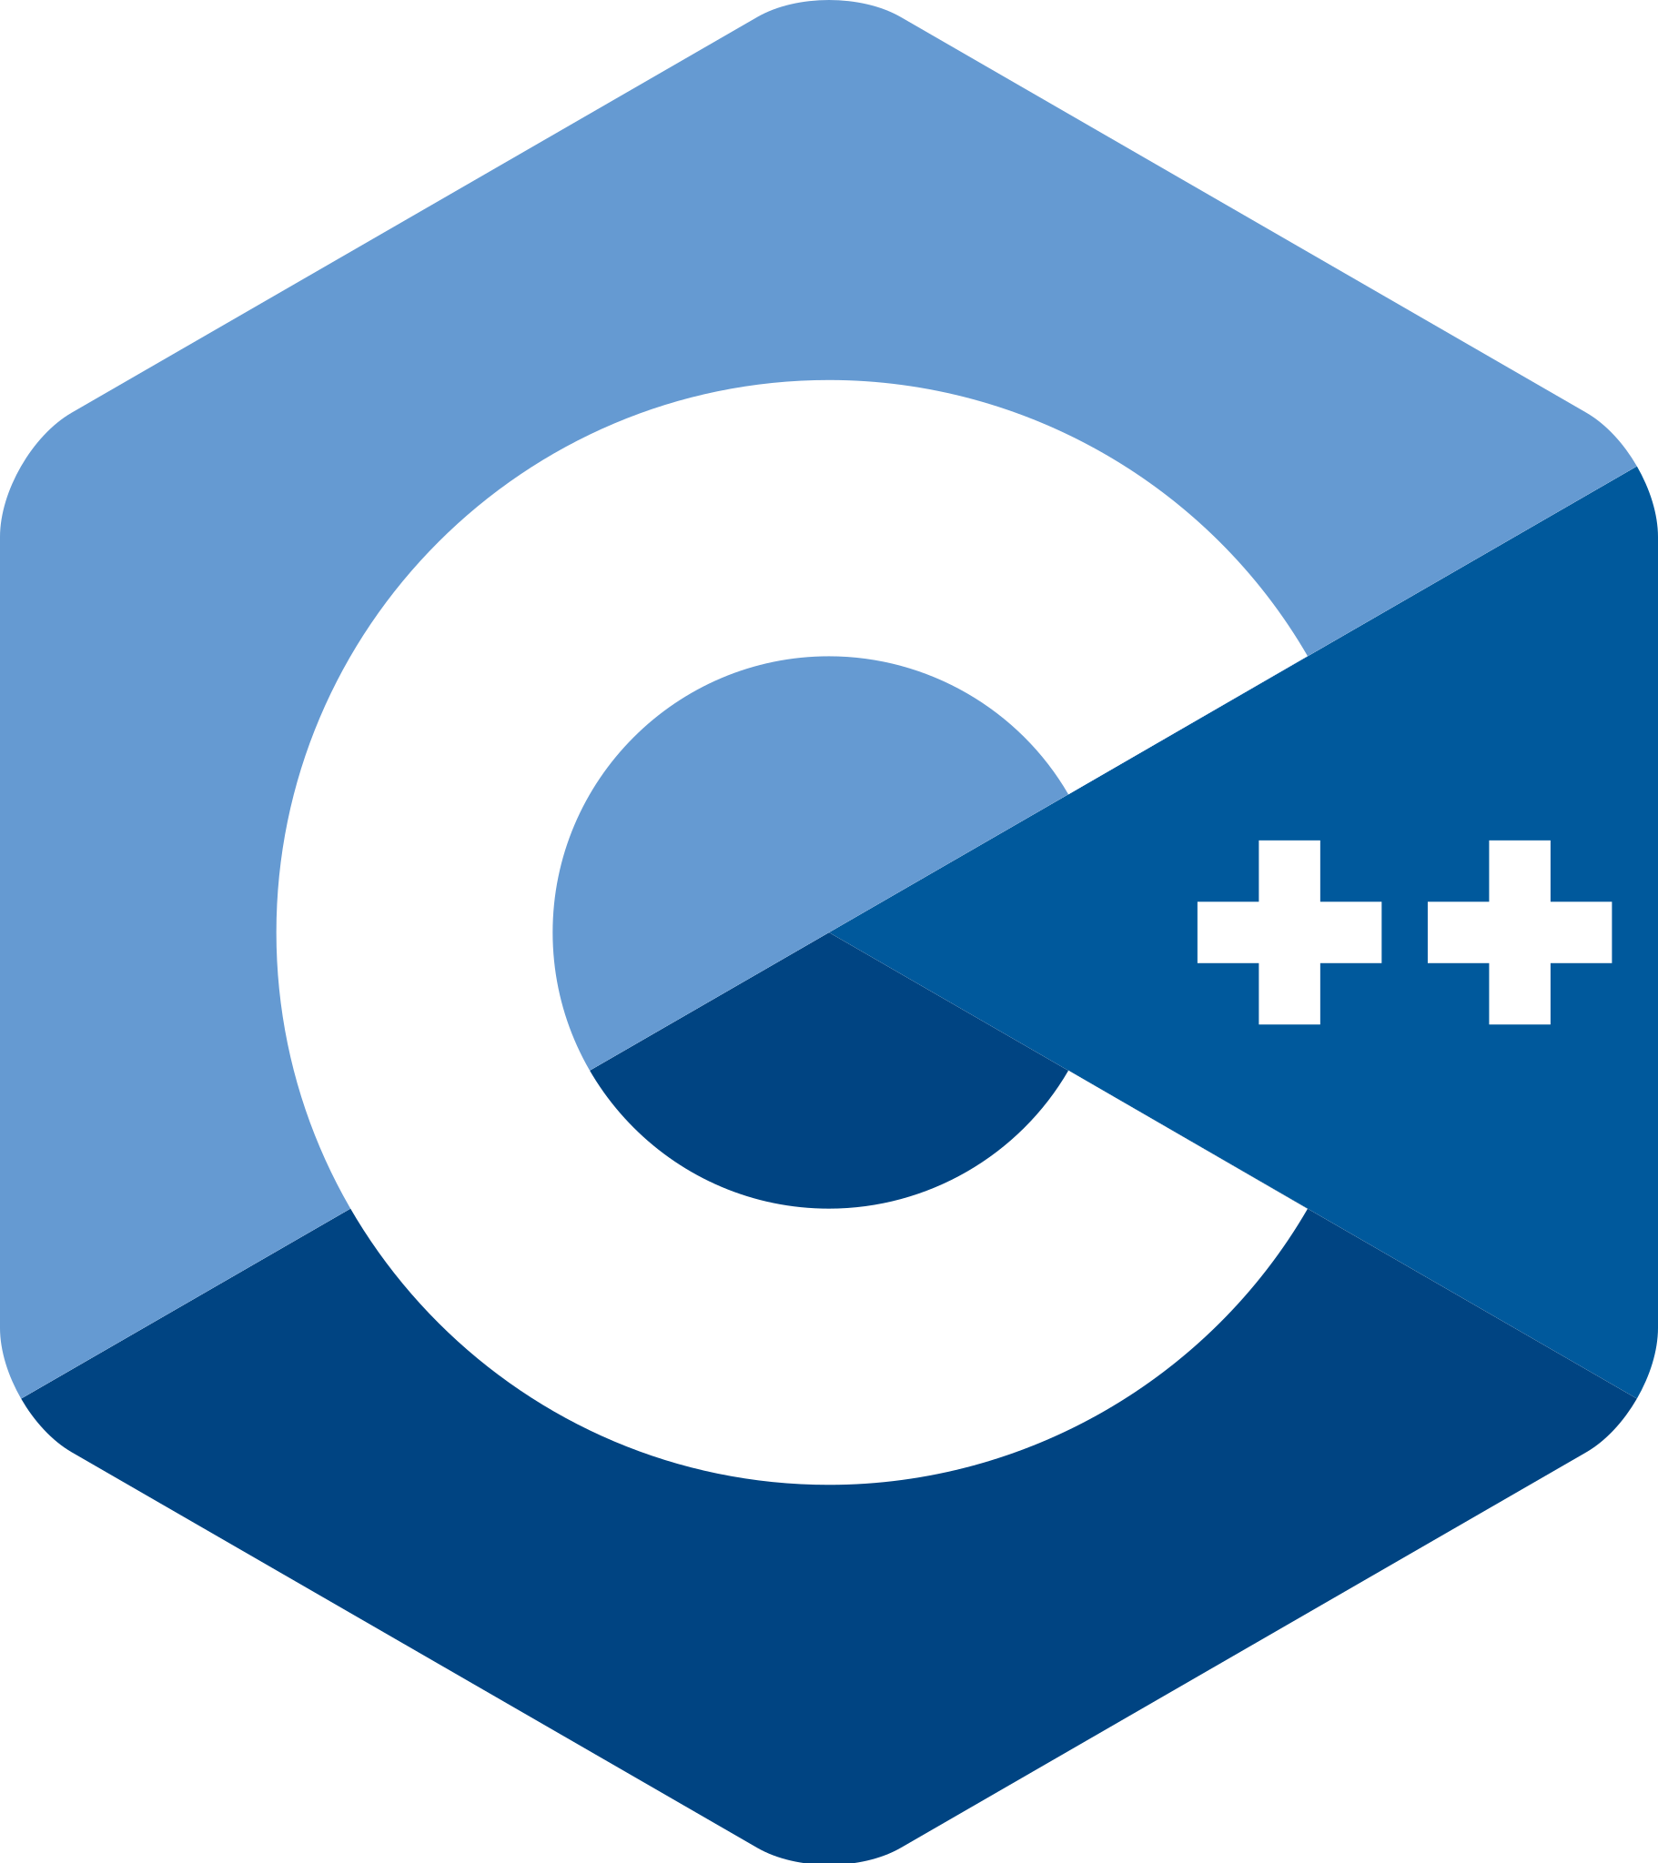
Python and C++
Both very common in many industries
Python:
Much more beginner friendly
Development is simpler
Very slow in execution
C++:
Very steep learning curve
High optimization potential + margins
(i.e. can be very fast)
Notes:
Python and C++ are the go-to languages for algorithm design and construction.
Both are built on the C language. C++ adds much more scalability and libraries to C, and Python’s compiler/interpreter is written in C.
These two languages can be used separately, but they also synergize incredibly well together.

Slide 25
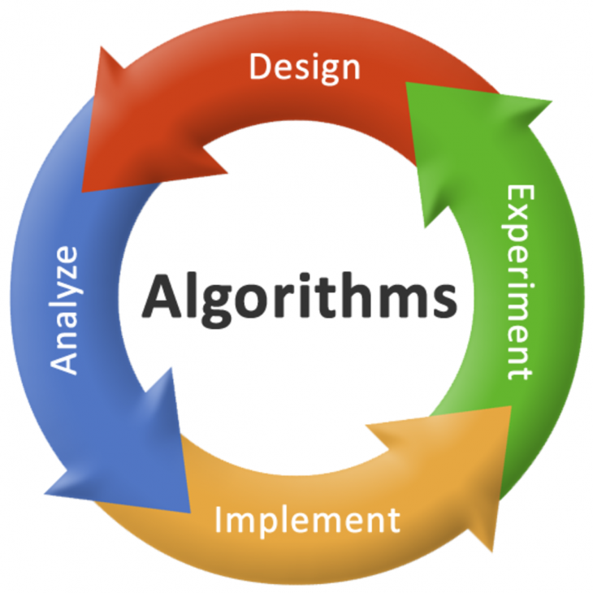
Algorithm Design
Notes:
Next we will talk about the languages that trade algorithms are written in.

Slide 26
High-level Questions to Consider
What problem are we solving?
How long do we have to develop a solution?
What response time constraints does this algorithm have?
What libraries (of code) can we use?
Has anyone else already made a solution?
If so, is theirs a good one and can we use it?
Notes:
High level questions are concerned about planning and overhead costs for programming projects.
You might have to consider the needs of a client or end user, etc, when making major project level decisions, such as language choice.

Slide 27
Low-level Questions to Consider
What should be our runtime complexity (big O)?
What will our code depend on (libraries, dependencies, etc.)
How will we test our algorithm?
Unit tests?
Integration testing?
Field testing?
Notes:
Low level questions are more focused on the actual process of writing the code itself

Slide 28
Let’s Design A (simple) Algorithm!

Slide 29
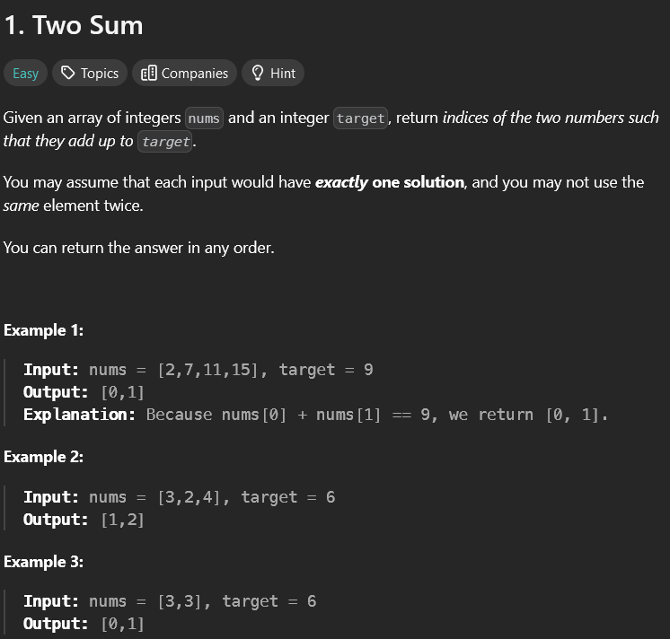
The Problem:
Found at: https://leetcode.com/problems/two-sum/
Notes:
Switch to leetcode to demonstrate code design process

Slide 30
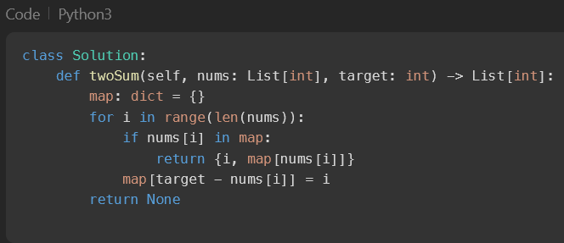
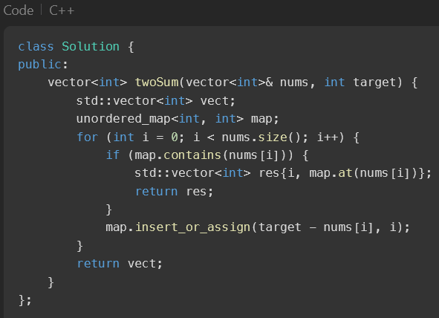
Python vs. C++
Notes:
Discuss the differences in readability, ease of design, etc.

Slide 31
Next CS lesson:
Intro to Python

Slide 32
Thank you for attending!

