Slide 1
Finance Workshop
Notes:
Introduce the presentation and say the idea behind it is that people can take pictures of the slides etc...

Slide 2
BrainTeaser
There's 100 coins in a row. They're labeled 1 to 100, and 10 of them are flipped up so tails is up the rest are heads up. You can flip as many coins you want, but you don't know which ones are flipped which way. Find a way to get two exact piles with the same number of tails.

Slide 3
BrainTeaser
Pull 10 coins apart and flip them all

Slide 4
What Is a Derivative?
Derivative
A derivative is a financial instrument whose value is based on the value of another underlying asset
When the price of the underlying changes, the value of the derivative also changes

Slide 5
What Is a Derivative?
Types of Derivatives
Forwards/Futures
Options
Swaps
Warrants/Convertibles

Slide 6
Option Example
An agreement that gives the buyer the right, but not the obligation, to buy an underlying asset at a specified price within a specific time period

Slide 7
Call option
An agreement that gives the buyer the right, but not the obligation, to buy an underlying asset at a specified price within a specific time period

Slide 8
Put option
An agreement that gives the buyer the right, but not the obligation, to sell an underlying asset at a specified price within a specific time period

Slide 9
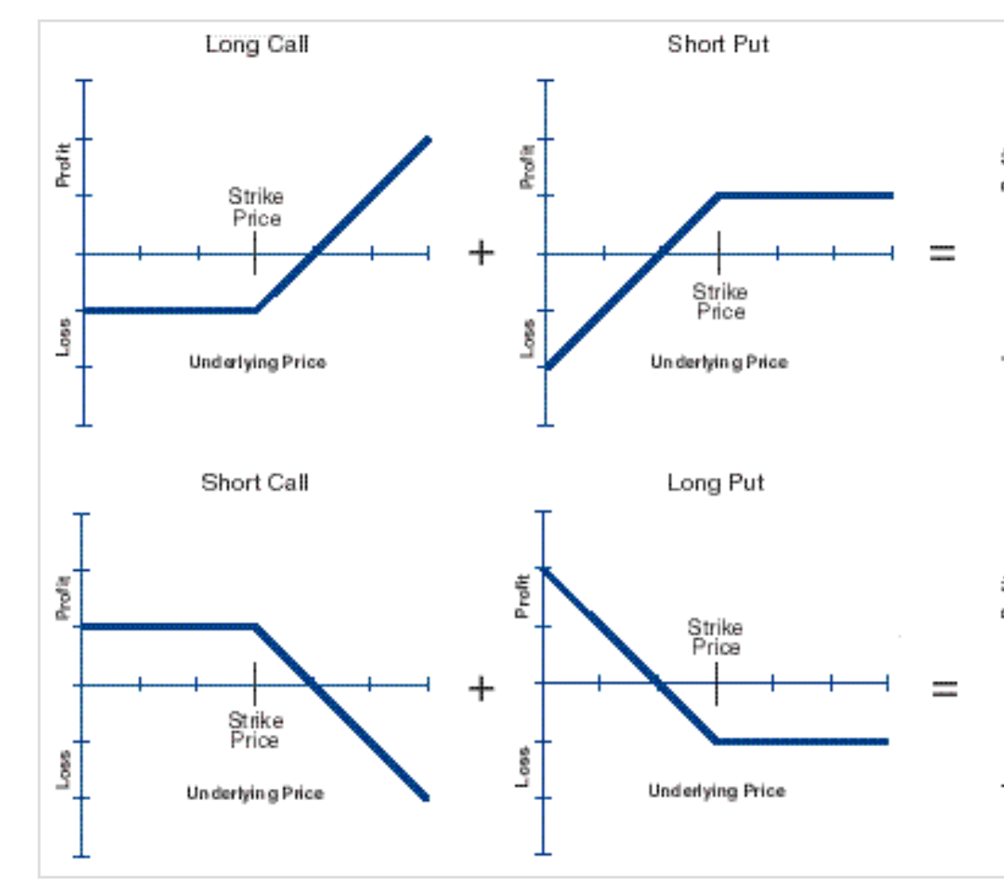

Slide 10
Trading Options - Where?
Similarly to how stocks are traded, through an exchange.
In the US, the largest options exchange is the Chicago Board Options Exchange (CBOE).
Others include:
MIAX
Boston Options Exchange
Eurex Exchange (largest European options market)
NYSE Arca Options
…
They provide a platform through which to trade standardised options.
Protect you against the risk of the counterparty defaulting.
(They protect themselves through client margin requirements, e.g. if you are selling options, you need capital deposited to cover potential losses).
Notes:
Example of why you don’t want counterparty to default

Slide 11
Trading Options - Where?
Trading platform through which you access these exchanges, e.g. Robinhood, Interactive Brokers, DEGIRO, etc.
Notes:
You don’t download the NYSE or LSE app, you use something like Trading 212
Worth noting options are really awkward to access as European retail investors
Choose market, product, strike price and dates

Slide 12
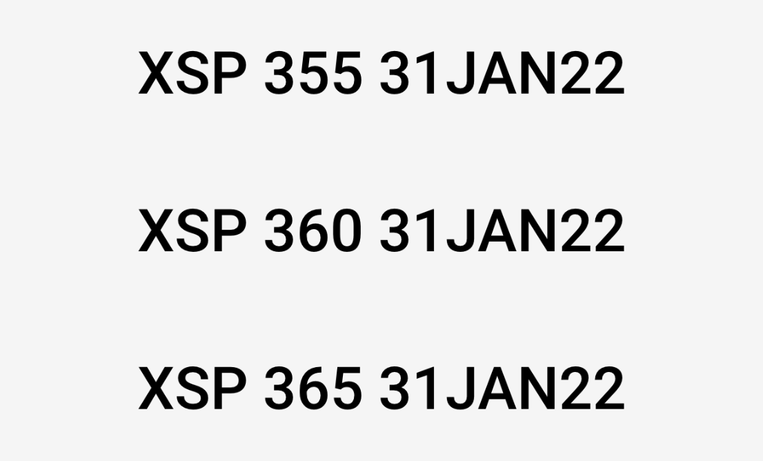

Slide 13
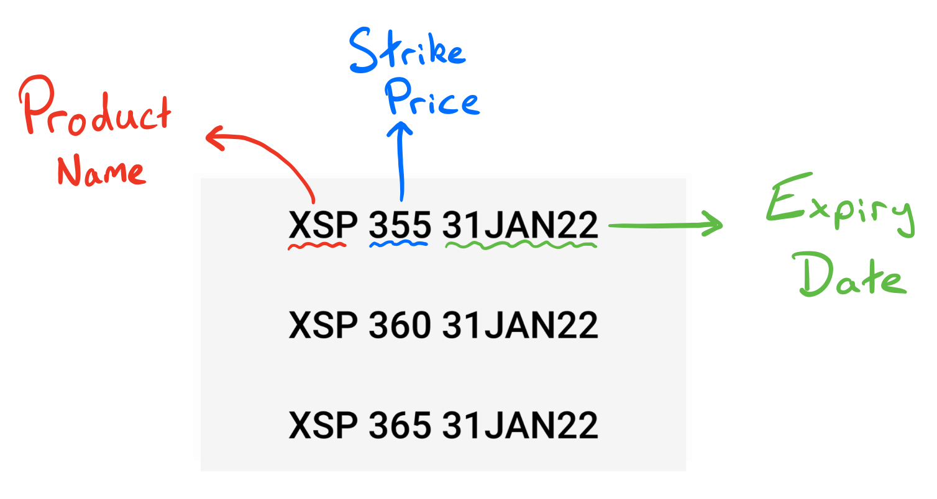

Slide 14
Trading Options - Why?
Hedging purposes
Commodity producers - Think oil companies, mining companies, farms
Commodity consumers - Energy companies, factories, etc.
Loss limitation (when buying options)
Cannot lose more than price of option vs. shorting stock (infinite losses)
For call options, positive exposure with capped maximum loss
Leverage
Potential for very high % returns, can make big gains with little capital
Construction of custom specific strategies
Notes:
Hedging - Anything with confirmed future flow of a security (either required or to sell)

Slide 15
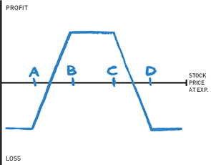
Options Strategy 3: Iron Condor
Selling iron condors is a great beginner strategy as it can be market-neutral (no directional bias), and it is a limited-risk strategy
The Setup:
Buy a put, strike A (long put)
Sell a put, strike B (short put)
Sell a call, strike C (short call)
Buy a call, strike D (long call)
Generally, the stock will be between strike price B and strike price C
Make profit when stock price remains above put spread, and below the call spread.

Slide 16
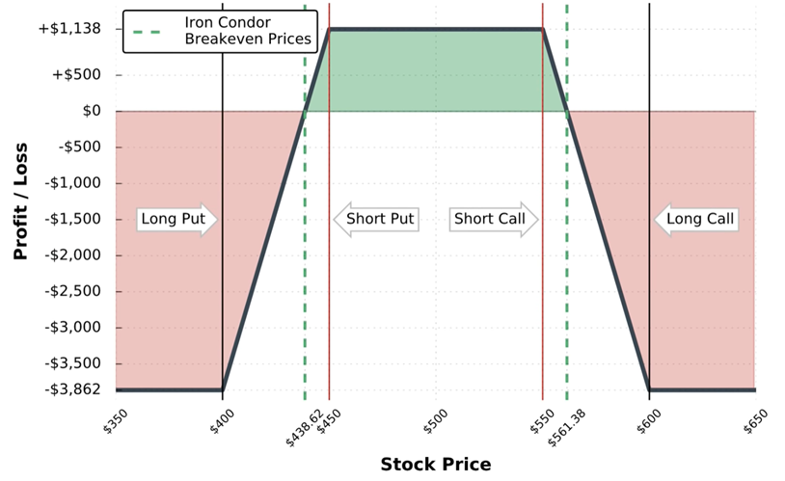
Notes:
Make profit when stock price is above put spread and below call sspread

Slide 17
REALIZED VOLATILITY VS IMPLIED VOLATILITY

Slide 18
The Greeks
Please feel free to raise your hand if anything isn’t clear or you have any questions!

Slide 19
The Greeks
Set of data points/parameters for a given option that describe its various properties.
Useful to determine how the option price will change with respect to other factors, such as volatility changes or a change in the underlying price.
Most important ones:
Delta (Δ) - Sensitivity to the price of the underlying security
Gamma (Γ) - Rate of change of delta
Theta (Θ) - Rate of time decay
Vega (ν) - Sensitivity to changes in volatility of the underlying security
Notes:
Harder to get head around than stock prices
Greeks help
Called “The Greeks” because they are all Greek letters

Slide 20
The Greeks - Delta
“Rate of change between the price of the option and a $1 change in the price of the underlying security”
For example, take Apple stock to be $100, and a (random, let’s say February) call option to have a delta of 0.5 and be worth $20 at the moment.
If Apple stock increased in price to $130 (a $30 increase), the call option price would increase by (0.5 * $30) = $15.
Hence the call option would now be worth $35.
Δ = 0.5
$30 increase in stock price
$15 increase in call option price
Δ = 0.1
$30 increase in stock price
$3 increase in call option price
Notes:
Each time underlying increases by $1, how much does the option increase by?
For the maths people, this is essentially got from differentiating the graph of the option price vs. the underlying price

Slide 21
The Greeks - Delta
(When buying options)
Call options - Positive Delta (0 to 1)
Put options - Negative Delta (-1 to 0)
Useful to determine if you have overall net positive or negative exposure on an asset, especially if you have multiple positions (which quant traders/market makers might have).
Options that are heavily “in the money” have delta close to 1 (or -1), whereas options very far “out the money” have deltas close to 0.
Can you think why this is intuitively?
Notes:
Maybe see if anyone wants to put their hand up and guess…?

Slide 22
The Greeks - Gamma
“Rate of change between delta (Δ) and a $1 change in the price of the underlying security”
Essentially, how “stable” an option’s delta is, how quickly it changes.
A high gamma (Γ) value means that the delta (Δ) could change very quickly if the underlying price changes only slightly (small increase/decrease).
Quite important to options traders and market makers, especially when they have positions which are not delta-neutral.
Γ = 0.1, $1 increase in stock price
Δ = 0.5
Δ = 0.6
Notes:
Gamma does continually change like delta, hence a $6 increase don’t result in a delta > 1

Slide 23
The Greeks - Gamma
(When buying options)
Call options - Positive Gamma (0 to 1)
Put options - Negative Gamma (-1 to 0)

Slide 24
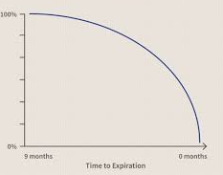
The Greeks - Theta
“Rate of decline of the value of the option over time”
Discussed time value earlier, theta (Θ) just measured the rate at which this occurs.
Essentially, differentiating the below graph once.
As you can see, theta is greatest when option is close to expiration.
Consequences? If you are holding an option on a stock with low volatility/price remaining near-constant, the value of your option declines rapidly, especially near expiration.

Slide 25
The Greeks - Vega
“Rate of change in price with a 1% change in implied volatility”
In general, higher volatility = higher option price (as there is a greater chance of hitting strike price at some point)
Vega (ν) lets us easily identify how rapidly an option price will change with volatility changes.
Notes:
Cover what “implied volatility” is, when it might be different to actual volatility

Slide 26
The Greeks - Vega
Why is Vega (ν) useful/important?
Upcoming news announcement
↓
Greater implied volatility
↓
Increase in option prices
If you are anticipating an unexpected news announcement the market is unaware of, you benefit from buying options.
Immediately after an important news announcement or significant price change, options will be relatively “expensive”, so sellers benefit.

Slide 27
The Greeks - Vega
(When buying options)
Call or Put options - Positive Vega (0 to 1)
Because options always increase in value with increased volatility.
Vega (ν) is also greatest for “at the money” options (as the probability of the option moving into profitability increases significantly with volatility increases).
Options very far “in the money” or “out the money” have a low value of vega (as the probability of them becoming profitable/not profitable is higher, but gone from “very very low” to “still pretty low”, e.g. not changed as much relatively).
Notes:
Note that this is the opposite if you sell the option, you have negative vega exposure

Slide 28
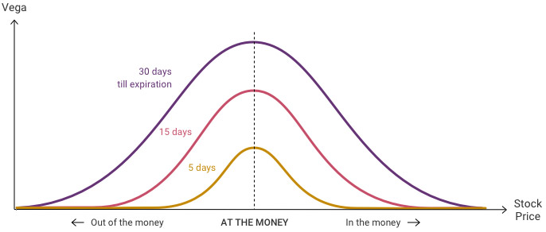
The Greeks - Vega
Credit

Slide 29
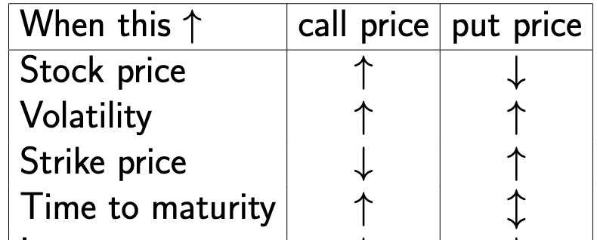
Credit

Slide 30
Black-Scholes
Credit

Slide 31
Black-Scholes
Credit

Slide 32
Black-Scholes
Credit

Slide 33
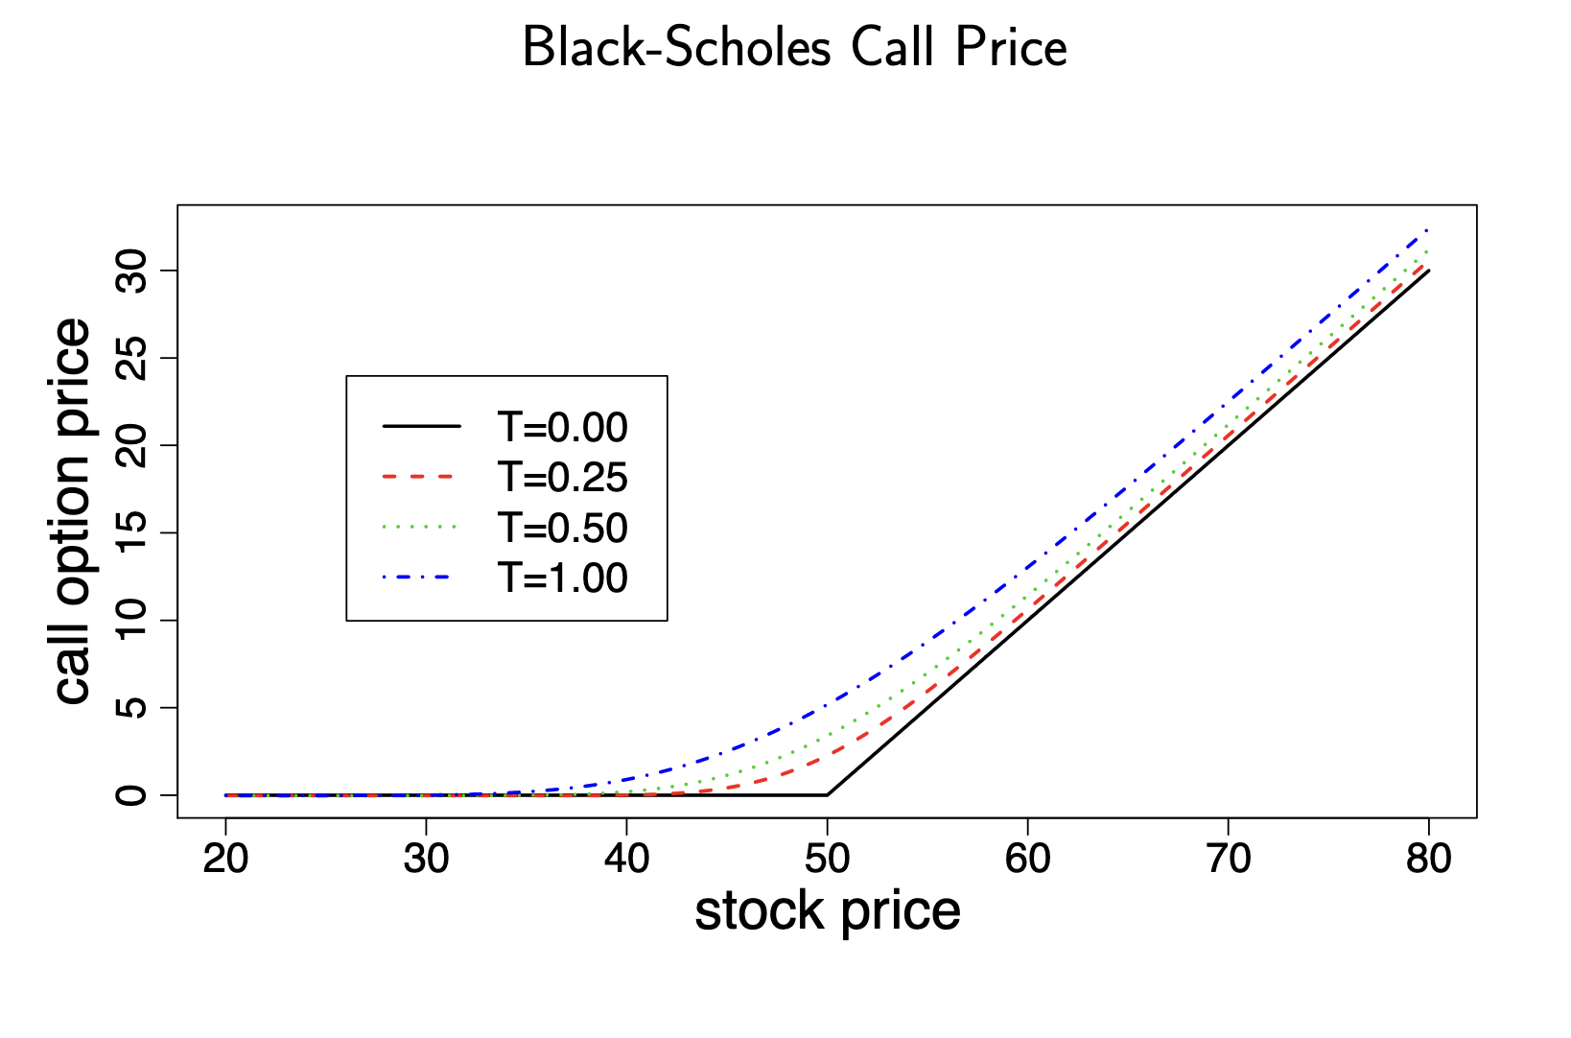
Black-Scholes
Credit

Slide 34
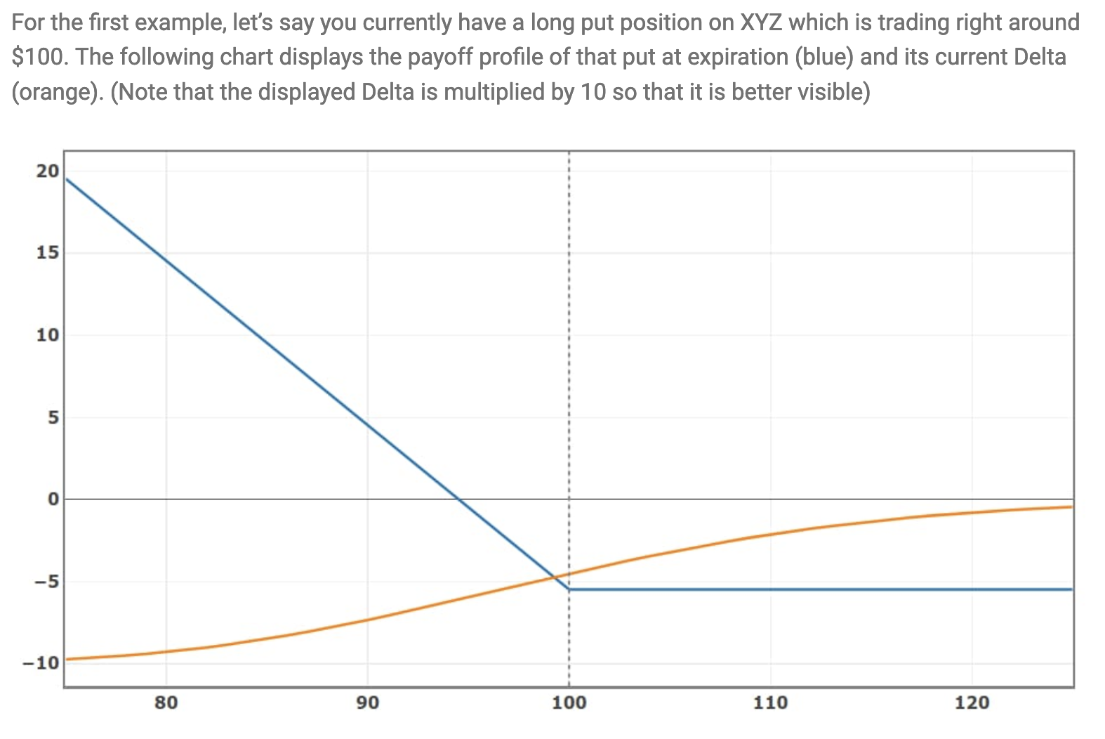
Delta Hedging/Gamma Scalping
Credit

Slide 35
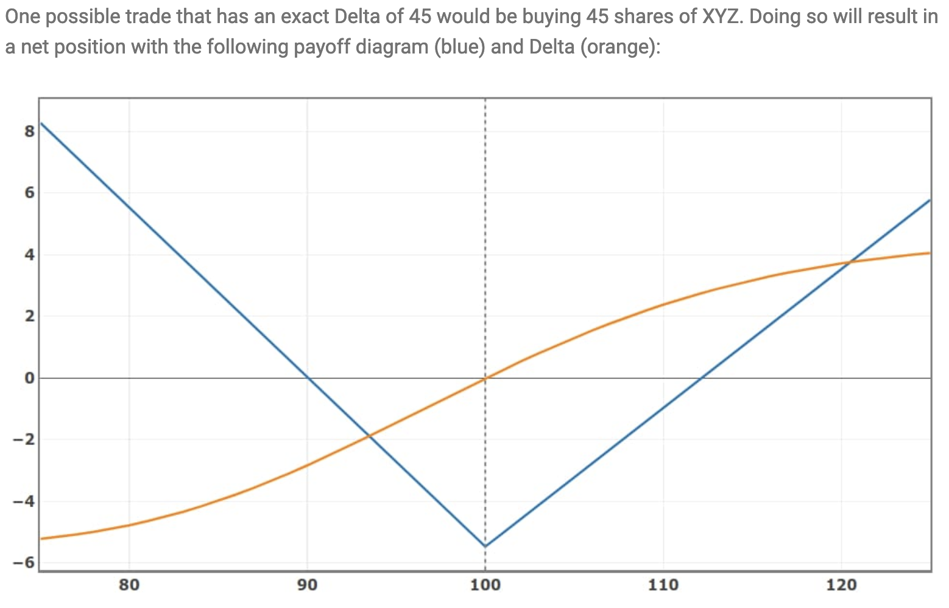
Delta Hedging/Gamma Scalping
Credit

Slide 36
Delta Hedging/Gamma Scalping
The primary benefit of delta hedging is mitigating the risk involved with adverse price fluctuations. Even more so, the case if a trader anticipates a strong price movement in the underlying stock but runs the risk of being over hedged if the stock does not meet the trader’s expectation.
On the contrary, delta hedging is subject to constant monitoring and rebalancing. A position may be rebalanced multiple times in line with price movements. A trader may be required to execute various buy and sell transactions to hedge the risk involved. As a result, the cost of hedging may increase.
Credit

